Slide 1
Tree Models
UIUC ECON 490: Applied Machine Learning in Economics

Slide 2
Motivation
The Titanic

Slide 3
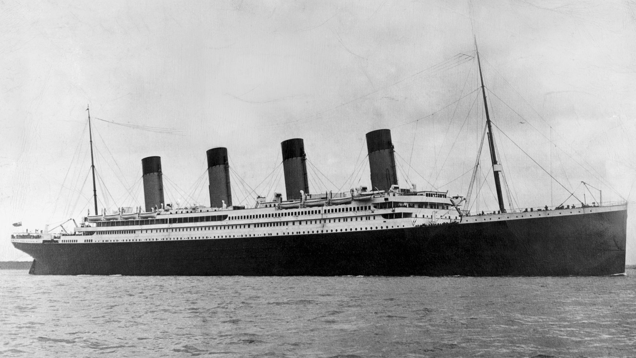

Varian (2014) – The Titanic
1309 passengers $(n)$
Survived $(y=1)$
Survival rate 38%
Predictors
Cabin class
Age
Sex
Siblings

Slide 4
Varian (2014) – Survival Rates
Survival rates by class
1st class – 62%
2nd class – 43%
3rd class – 25%
Survival rates by age
0-10 – 58%
11-20 – 39%
21-30 – 37%
Etc.
Survival rates by gender
Females – 73%
Males – 19%
Non-linearities
1st class females – 97%
2nd class females – 89%
3rd class females – 49%

Slide 5
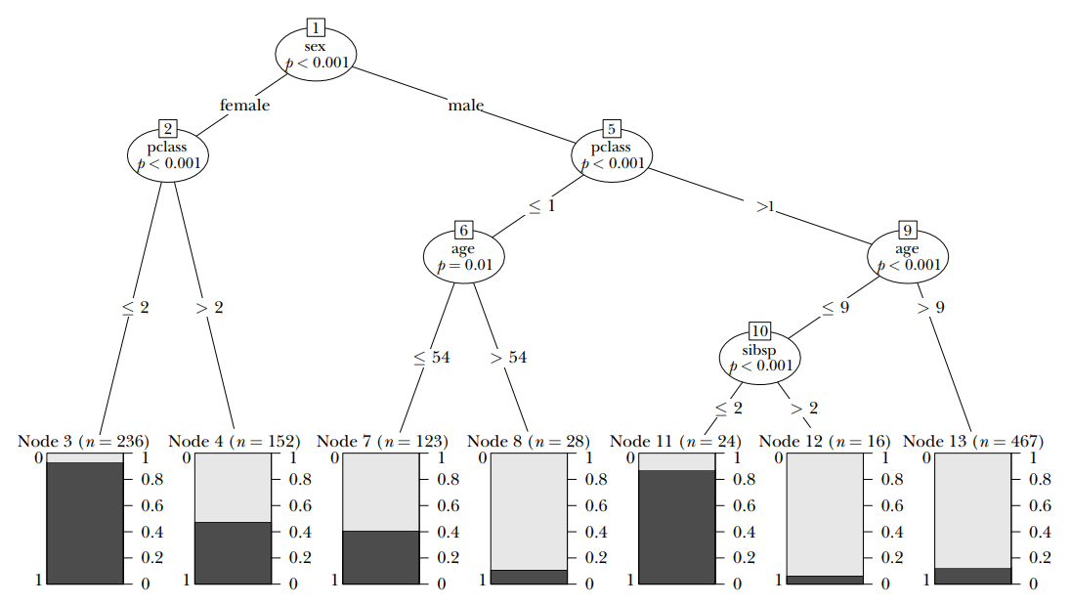
Varian (2014) – Decision Tree

Slide 6
Varian (2014) – Decision Tree
Nodes

Slide 7
Varian (2014) – Decision Tree
Leaves

Slide 8
Varian (2014) – Decision Tree
Branches

Slide 9
Tree Models
How to construct regression-trees

Slide 10
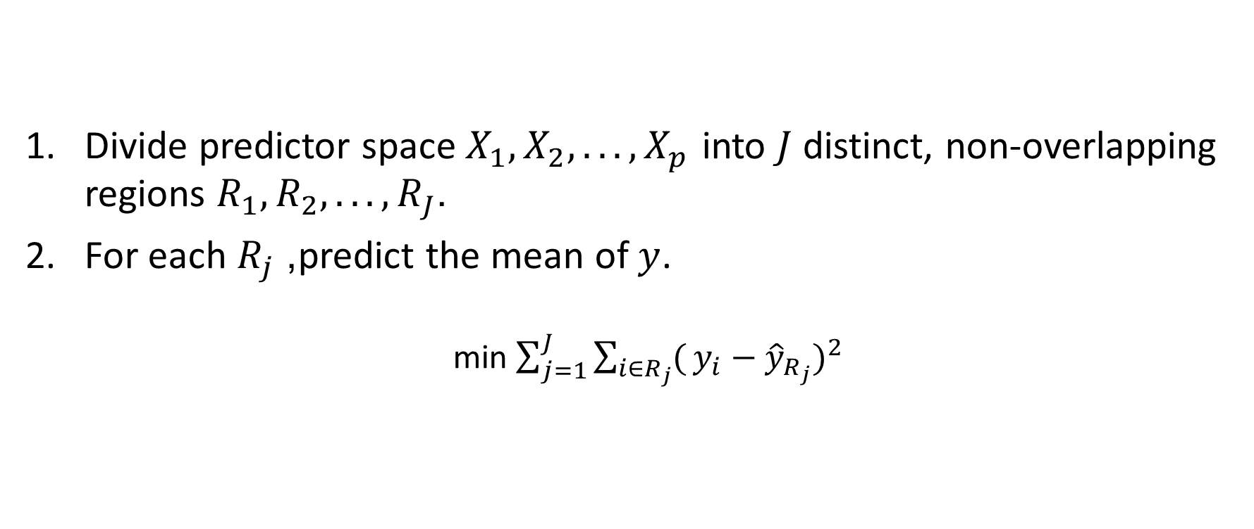
Prediction
Divide predictor space $X_{1},X_{2},...,X_{p}$ into $J$ distinct, non-overlapping regions $R_{1},R_{2},...,R_{J}$.
For each $R_{j}$, predict the mean of $y$.
min $\sum_{j=1}^{J}{\sum_{i∈R_{j}}^{​}{(}}y_{i}−{\hat{y}}_{R_{j}})^{2}$

Slide 11
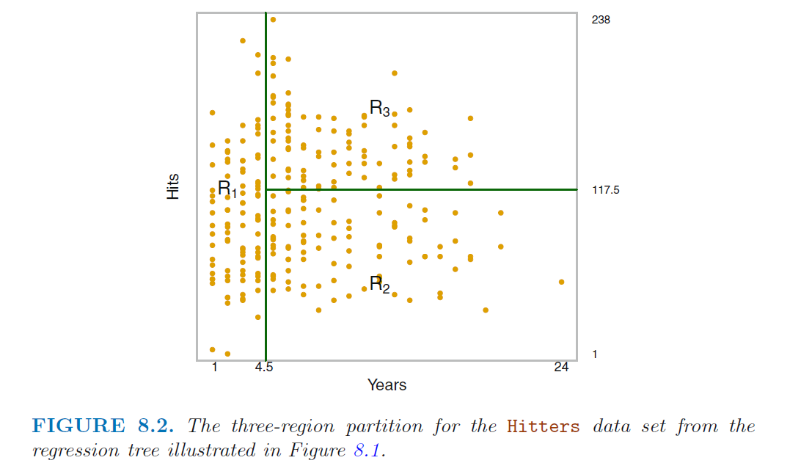
Regions

Slide 12
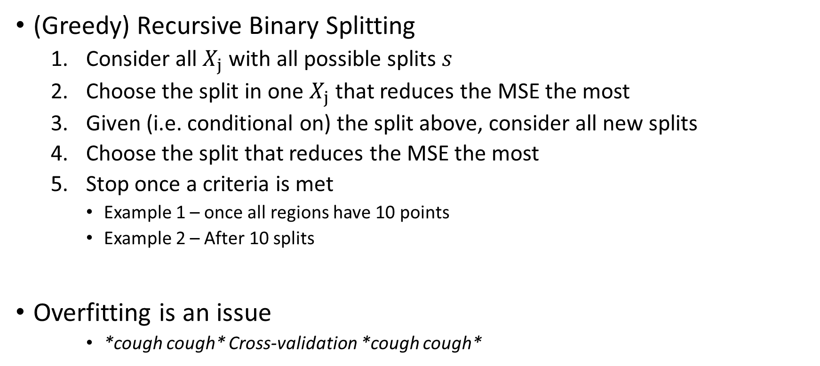
Choosing Regions
(Greedy) Recursive Binary Splitting
Consider all $X_{j}$ with all possible splits $s$
Choose the split in one $X_{j}$ that reduces the MSE the most
Given (i.e. conditional on) the split above, consider all new splits
Choose the split that reduces the MSE the most
Stop once a criteria is met
Example 1 – once all regions have 10 points
Example 2 – After 10 splits
Overfitting is an issue
*cough cough* Cross-validation *cough cough*

Slide 13
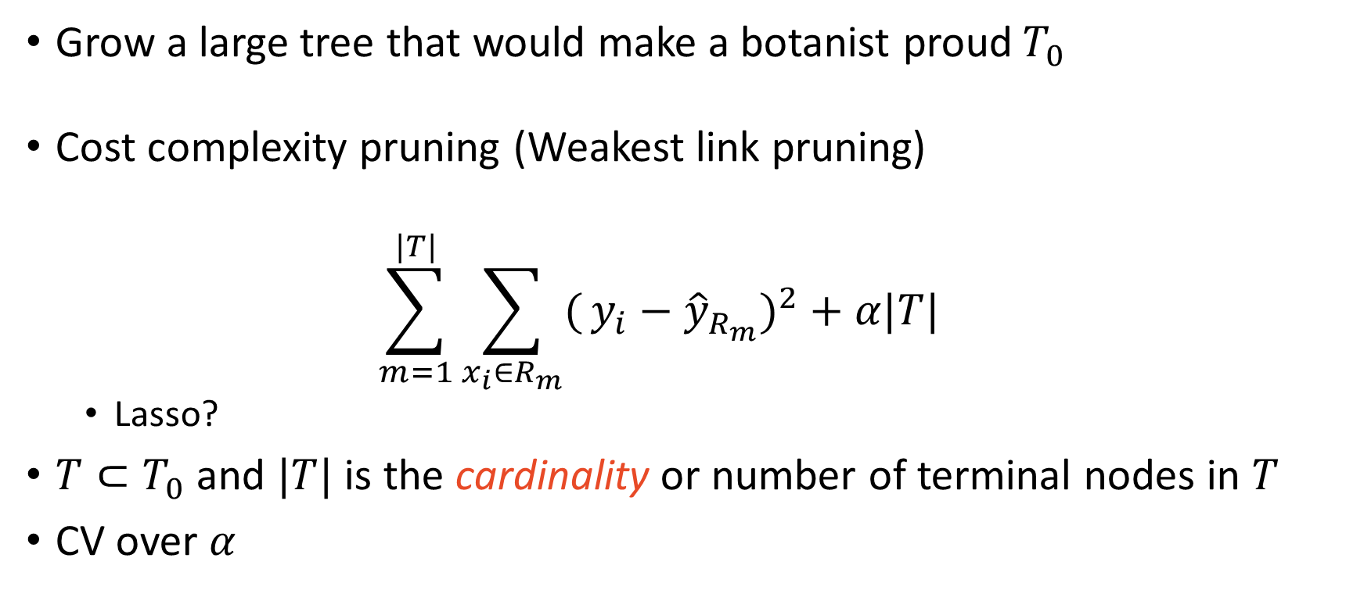
Tree Pruning
Grow a large tree that would make a botanist proud$T_{0}$
Cost complexity pruning (Weakest link pruning)
$$\sum_{m=1}^{|T|}{\sum_{x_{i}∈R_{m}}^{​}{(}}y_{i}−{\hat{y}}_{R_{m}})^{2}+α|T|$$
Lasso?
$T⊂T_{0}$ and $|T|$ is the cardinality or number of terminal nodes in $T$
CV over $α$

Slide 14
Types of Problems
Regression
MSE
Classification
Error rate
May not be sensitive enough
Gini index
Entropy
See textbook for formulas

Slide 15
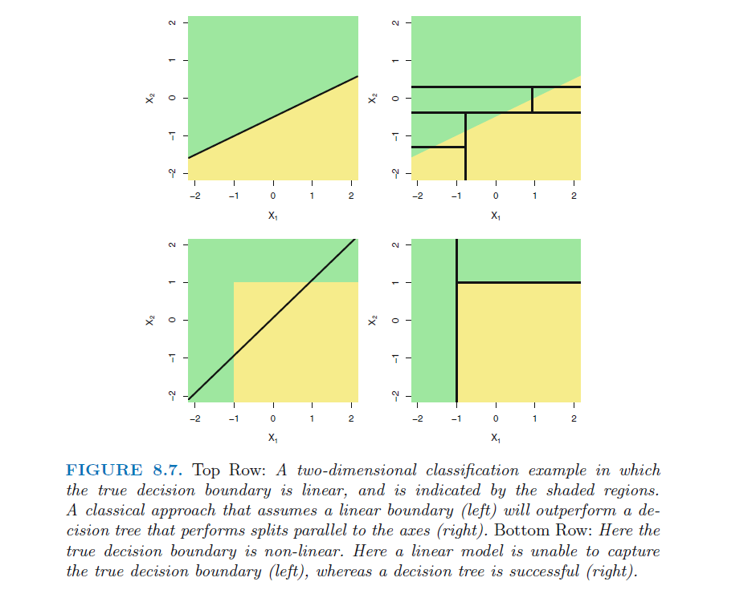
Trees Versus Regression

Slide 16
Pros and Cons of Trees
Pros
Ease of explanation
Mirrors human decision-making
Graphically displayed
Qualitative predictors do not need dummy variables
Cons
Not very competitive
Sensitive to minor changes in initial conditions

Slide 17
Coming soon, to a lecture near you…
Bagging
Random Forests

